Slide 1
Customer Data Analysis & Business Insights
EDA, Dashboard & Insights Poorvitha M
Role: Data Analyst Intern
Project: ApexPlanet Task 4

Slide 2
Objective
Analyze customer distribution and behavior
Identify key patterns and trends
Provide actionable business insights

Slide 3
Dataset
Total Records: 793
Columns: id, name, segment, state, city
Data type: Mixed (categorical + numeric)
No missing values / cleaned dataset

Slide 4
Exploratory Data Analysis
Segment-wise customer distribution analyzed
State-wise concentration identified
Feature engineering: name_length

Slide 5
Dashboard
Interactive dashboard created using Excel
Visualizations:
Segment distribution (Bar chart)
State-wise customer count
Helps in quick decision-making

Slide 6
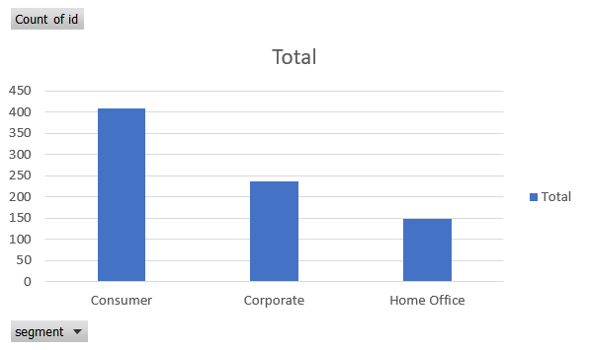
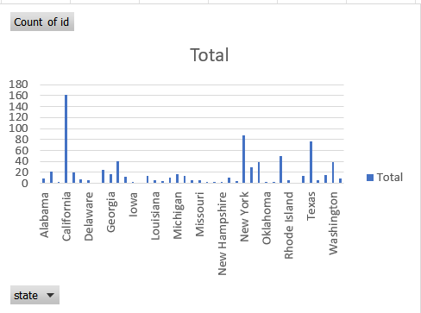
Dashboard Visuals
Segment chart
State chart

Slide 7
Insights
Consumer segment dominates (~50%+)
California has the highest customer concentration
Customer base is highly uneven across states
Few regions contribute majority of customers

Slide 8
Hypothesis Testing
Hypothesis: “Customer distribution varies significantly by segment”
Method: Basic comparison / observation
Result: Consumer segment has significantly higher count
Conclusion: Business should focus more on Consumer segment

Slide 9
Conclusion
Focus marketing on high-performing segments
Target top states like California & New York
Use data-driven strategies for growth

